Slide 1
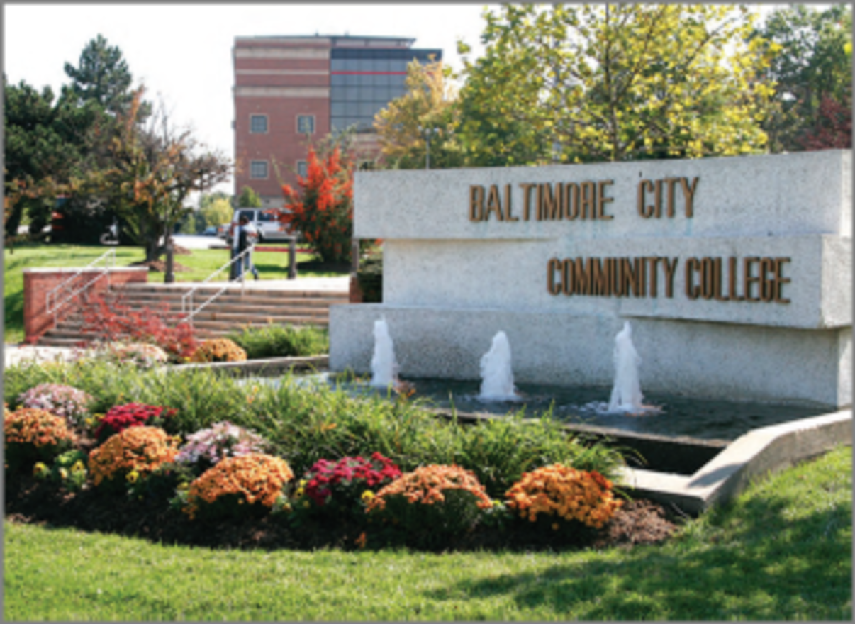
DATABASE CMS FOR BALTIMORE CITY COMMUNITY COLLEGE

Slide 2
TEAM MEMBERS CHRISTIAN SAULS, MATT CLARK, JACOB DELLA, DALTON BROWN

Slide 3
INTRODUCTION
Baltimore City Community College desires a database and an application to display specific queries and information.
Their departments heavily rely on paper and manual labor to store information on day-to-day functions and generate reports. This can take days and is far from optimal.
Due to the departments decentralized management the backlog of searching and finding records on visitors, students and staff becomes extremely laborious.
PeopleSoft is not an option for BCCC as they cannot afford the licensing fees and its relatively poor performance.
We worked together with BCCC to develop and design an ERD, schema and associated application.

Slide 4
USER REQUIREMENTS
Expected Queries
List the names of the courses offered by a specific program.
List what courses are offered in a specific department during a specific semester.
List the first and last names of staff that teach a course in a specific program.
List the first and last names of staff that are also an advisor.
List the first and last names of students who has a specific staff member as an advisor.
Retrieve how many students withdrew/dropped a specific course during a specific
semester.
Generate a list of professors who have taught at Baltimore City Community College for
more than or equal to five years as of a specific semester.
List all of the first and last names of students enrolled in a specific program who are
female.
Find the name of the student who has a specific ID no.
List the grade records all of the courses during a specific semester for a particular student.

Slide 5
USER REQUIREMENTS
Application requirements
Provide a usable GUI to make usage easier
Provide faster querying and report generation than our competitor PeopleSoft
Provide meaningful, easy to view reports.
Allow the program to be expanded upon in the future based on the needs of the customer
Allow the user to execute queries if needed
Allow user to perform all expected queries in a GUI environment

Slide 6
DATA MODEL REQUIREMENTS
Allow user to update all tables.
Allow user to access specific information for students, staff, courses, etc.
Allow user to generate a list of the number of students currently assigned under a specific
department.
Allow user to generate a list of staff assigned to a specific course.
Allow user to generate a list of courses offered by a program during a specific semester.
Allow user to retrieve grade records for a specific course.
Allow user to retrieve grade records for each student.
Allow user to retrieve a list of visitors on a specific day.
Allow user to separate information according to identification status (student, staff, or
visitor).
Allow user to verify all students have an advisor.

Slide 7
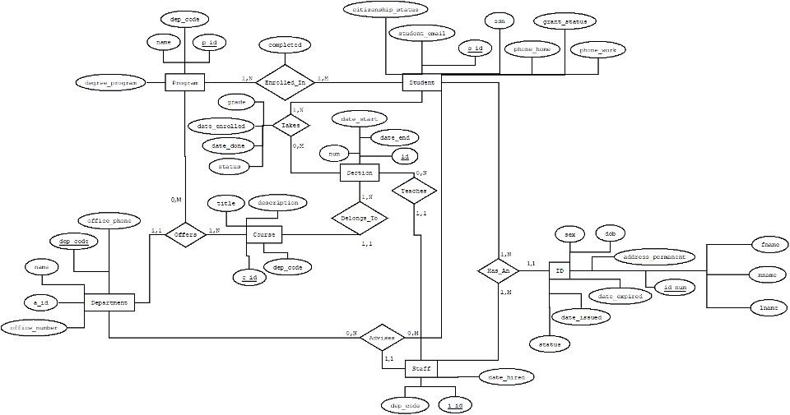
DATA MODEL / ERD

Slide 8
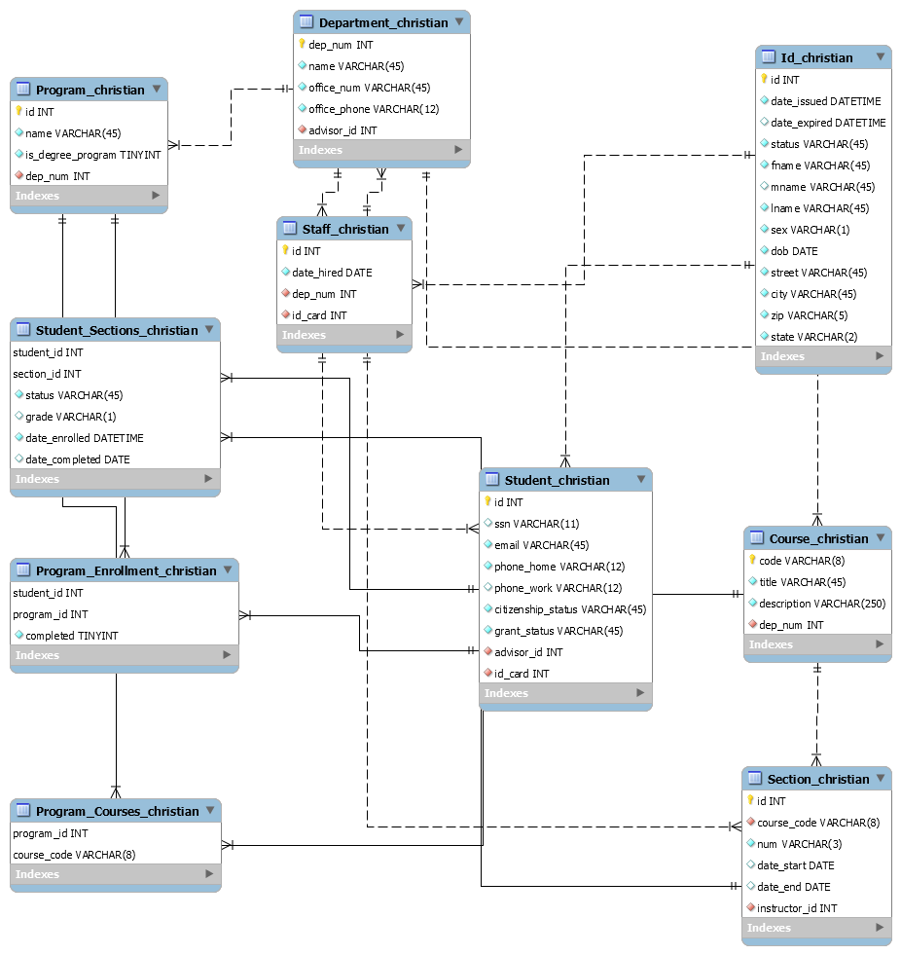
DATA MODEL / SCHEMA

Slide 9
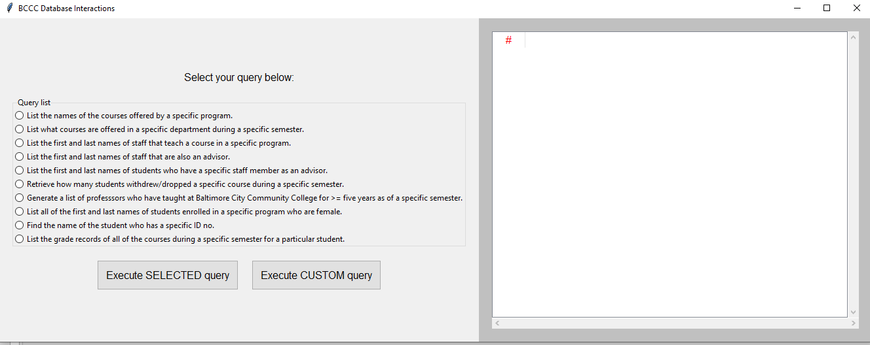
APPLICATION
Application is written in Python 3 and utilizes the built-in library Tkinter to create GUI windows
One external library is required to connect to the database, mysql.connector
Application currently doesn’t have a user login implemented yet, this will be implemented in future releases

Slide 10
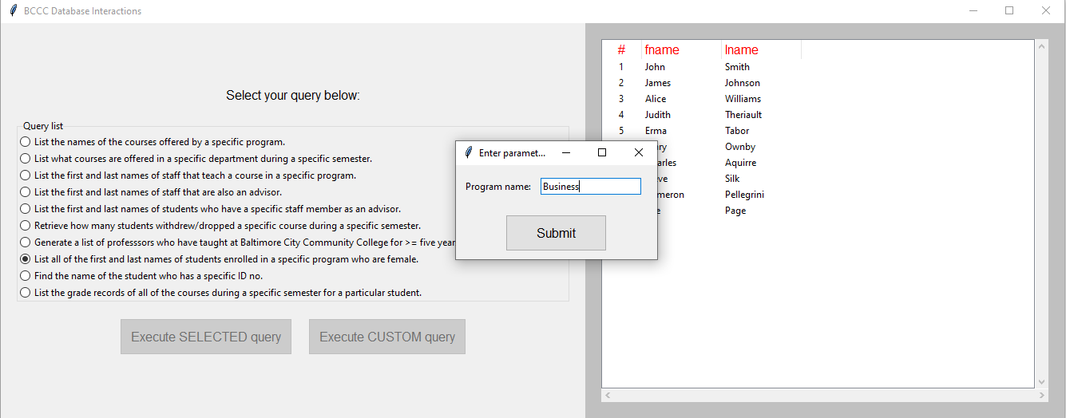
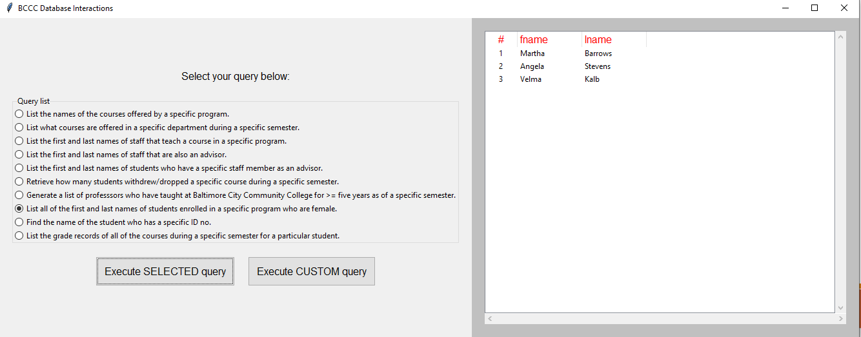
APPLICATION
Application is designed to be very simple to use.
Simply click a query on the query list, click execute and a window will pop up prompting the user for the parameters of that report.
After parameters are entered hitting submit will execute the query.

Slide 11
IMPLEMENTATION DETAILS
Database password and cursor object is stored inside of the Python script
The entire application is a single monolithic Python script
The current version of the application needs to be launched via the terminal and displays real time debugging output to help fix issues and database problems.
Utilizes many Python language paradigms to make easily maintainable code.

Slide 12
LIVE DEMO

Slide 13
THANK YOU FOR YOUR ATTENTION!

